Slide 1
CSC 101 Introduction to Computing Lecture 2
Dr. Iftikhar Azim Niaz
ianiaz@comsats.edu.pk

Slide 2
Last Lecture Summary
Course Outline
What is a computer?
Comparison of Computer with Human
History of Computers
Developments in Microcomputers
From 1965 to 1984
Notes:
Course Outline
Course outline and recommended books
Marks distribution
Text Book contents at a glance chapter wise
What is a Computer
Definition of Computer
Anatomy of Computer
Comparison of Computer with Human
History of Computers
Analog and Digital Computers
Abacus, Pascaline, Babbage Difference Engine, Punched Cards
Mark I, ENIAC
Developments in Microcomputers from 1965 to 1984
DEC PDP 8, Intel Microprocessors, Floppy disk
Apple I, Commodore PET, Osborne I, IBM PC
Apple Macintosh, MS windows and Laser Jet Printers
Generation of Computers 1st to 5th Vaccum Tubes, transistors, ICs, VLSI and Artificial Intelligence Based computers

Slide 3
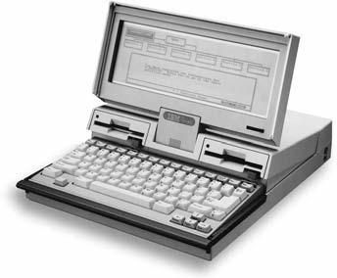
First Laptop Computer
1986 IBM delivers the PC convertible, IBM’s first laptop computer and the first Intel-based computer with a 3.5-inch floppy disk drive.
3

Slide 4
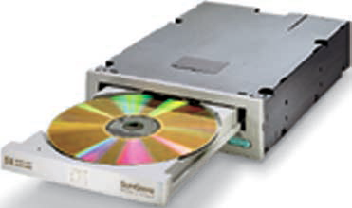
Compact Disk (CD)
1986 First International Conference on CD-ROM technology is held in Seattle, hosted by Microsoft.
Compact discs are seen as the storage medium of the future for computer users.
4

Slide 5
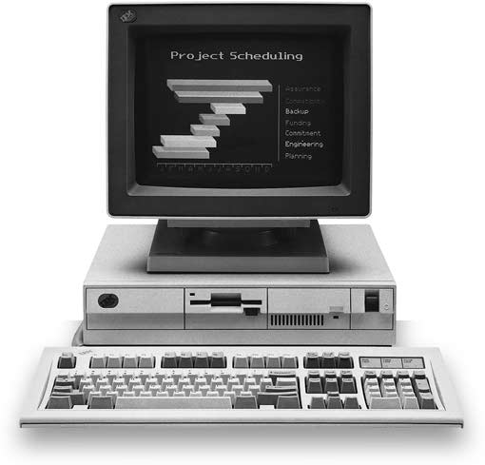
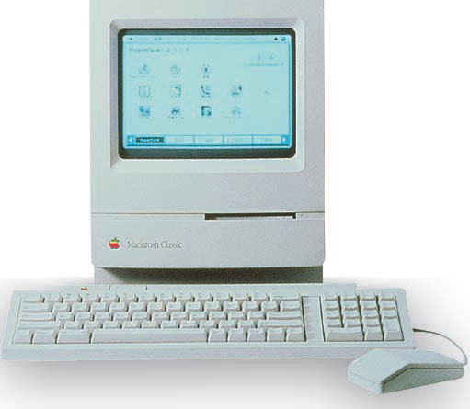
1987
IBM unveils new PS/2 line of computers, featuring a 20-MHz 80386 processor.
IBM used Video Graphics Array (VGA) monitor offering 256 colors at 320 X 200 resolution, and 16 colors at 640 X 480.
Macintosh II with Motorola 68030
5

Slide 6
1989
Intel releases 80486 chip
World Wide Web created at CERN for use by scientific researchers
Microsoft introduced Word for Windows
Previously, Word for DOS had been the second-highest-selling word processing package behind WordPerfect.
6

Slide 7
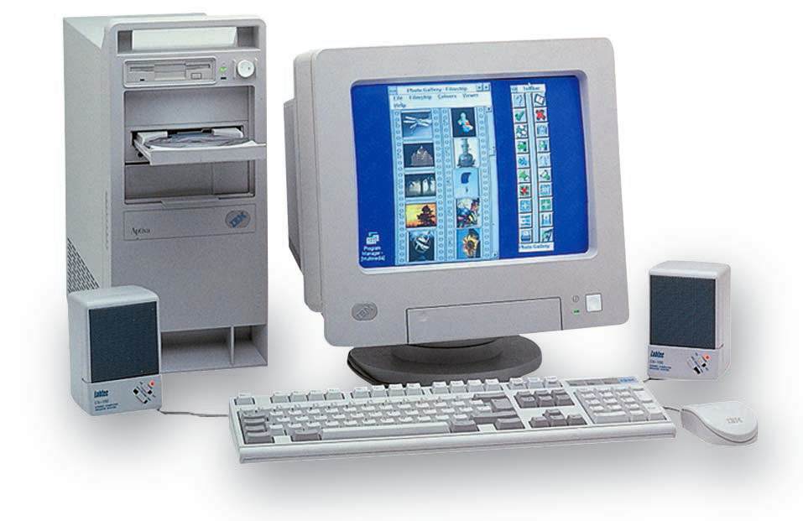
1990 ARPANET
The National Science Foundation Network (NSFNET) replaces ARPANET as the backbone of the Internet.
Motorola announces its 32-bit microprocessor, the 68040, incorporating 1.2 million transistors
7
Notes:
The U.S. Advanced Research Projects Agency Network (ARPANET) was the first public packet-switched computer network. It was first used in 1969 and finally decommissioned in 1989. ARPANET's main use was for academic and research purposes

Slide 8
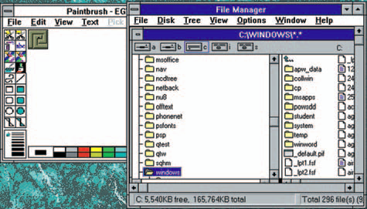
1990 Microsoft Windows
Microsoft releases Windows 3.0, shipping one million copies in four months.
8

Slide 9
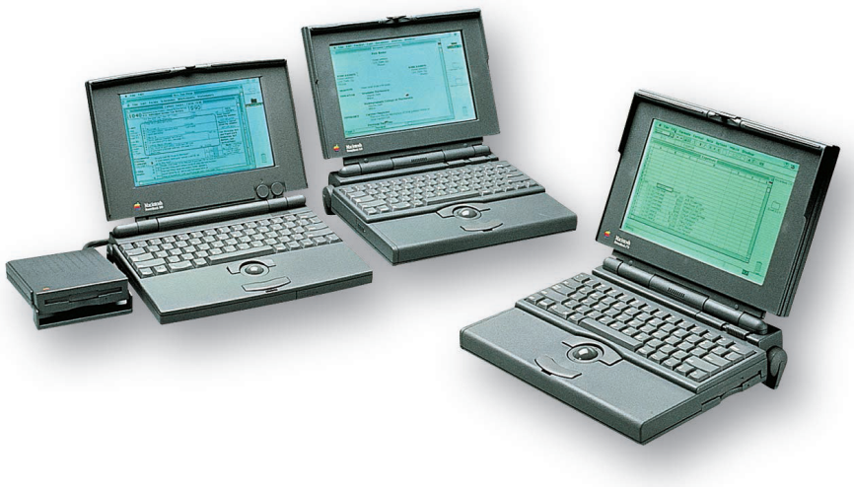
1991
Linus Torvalds releases the source code for Linux 0.01 (a clone of UNIX for the 80386 personal computer) on the Internet.
Apple Computer launches the PowerBook series of battery powered portable computers.
RISC based chips are used in Power PC microprocessors
9

Slide 10
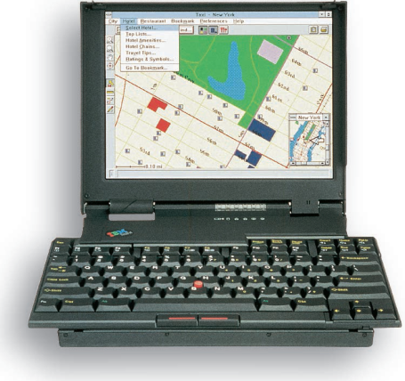
1992
Internet becomes the world’s largest electronic mail network.
Microsoft ships the Windows 3.1 operating environment, including improved memory management and TrueType fonts.
IBM introduces its ThinkPad laptop computer.
10

Slide 11
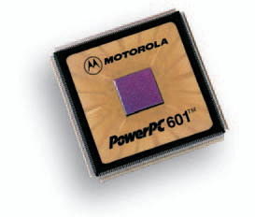
1993
Microsoft ships the Windows NT operating system.
IBM ships its first RISC-based RS/6000 workstation,
featuring the PowerPC 601 chip developed jointly by Motorola, Apple, and IBM.
11

Slide 12
1995
Intel releases the Pentium Pro microprocessor.
Motorola releases the PowerPC 604 chip, developed jointly with Apple and IBM.
Microsoft releases its Windows 95 operating system
Netscape Communications captures more than 80 % of the World Wide Web browser market,
Going from a start-up company to a $2.9 billion company in one year.
Sun Microsystems create the Java development language.
Because it enables programmers to develop applications that will run on any platform,
Power Computing ships the first-ever Macintosh clones, the Power 100 series with a PowerPC 601 processor.
eBay, the premier online auction house, is formed.
12

Slide 13
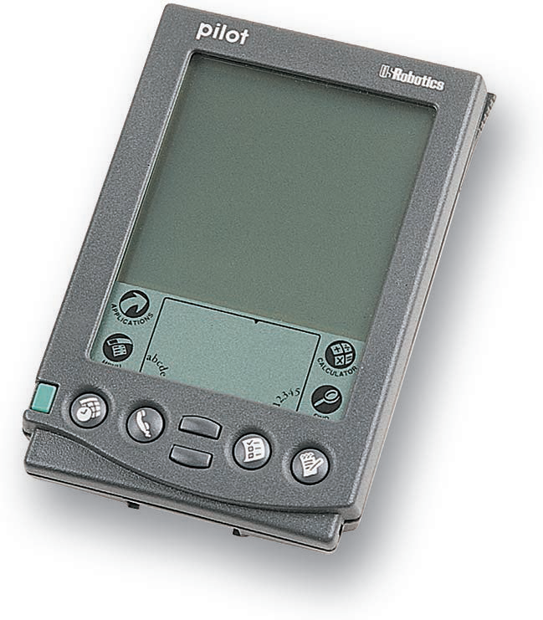
1996
Intel announces the 200 MHz Pentium processor
U.S. Robotics releases the PalmPilot, a personal digital assistant
Microsoft adds Internet connection capability to its Windows 95 operating system.
Sun Microsystems introduces the Sun Ultra workstation that includes a 64-bit processor.
13

Slide 14
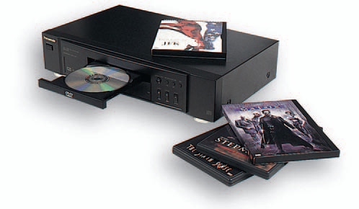
1997
Intel announces MMX technology
which increases the multimedia capabilities of a micro-processor. Also, Intel announces the Pentium II microprocessor. It has speeds of up to 333 MHz.
Digital Video/Versatile Disc (DVD) technology is introduced.
14

Slide 15
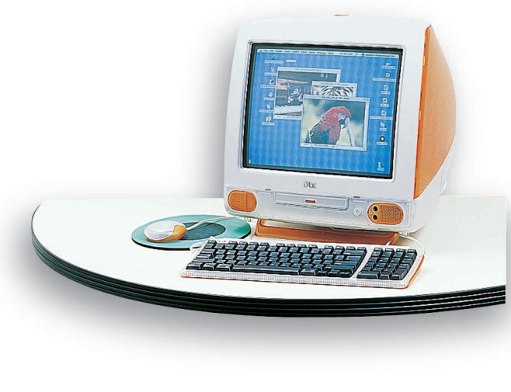
1998
Microsoft releases the Windows 98 operating system
It also offers improved Internet-related features, including a built-in copy of the Internet Explorer Web browser
Apple Computer releases the colorful iMac, an all-in one system geared to a youthful market
15

Slide 16
1999
Intel unveils the Pentium III processor, which features 9.5 million transistors
With its Athlon microprocessor, Advanced Micro Devices (AMD) finally releases a Pentium-class chip that outperforms the Pentium III processor
Peter Merholz coins the term blog, a contraction of Web-log
The Internet Assigned Number Agency begins assigning Internet Protocol addresses using the new IPv6 addressing structure
16

Slide 17
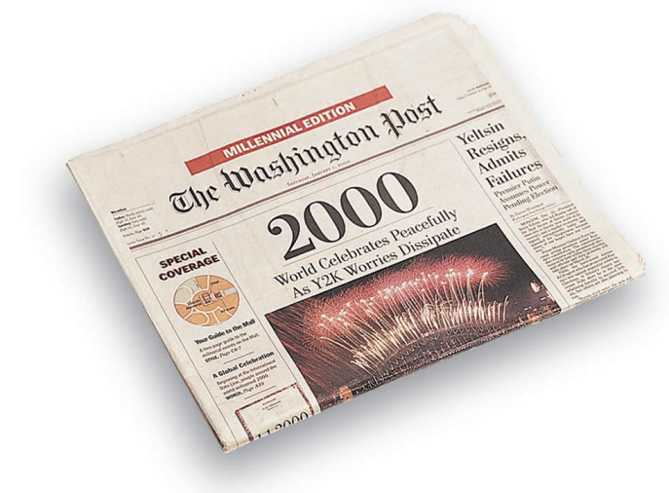
2000
Y2K issue
No major damage resulted from the “millennium date change
Microsoft introduces Windows 2000 on February 17.
biggest commercial software project ever attempted involving 5,345 full-time participants
final product includes almost 30 million LOC
17

Slide 18
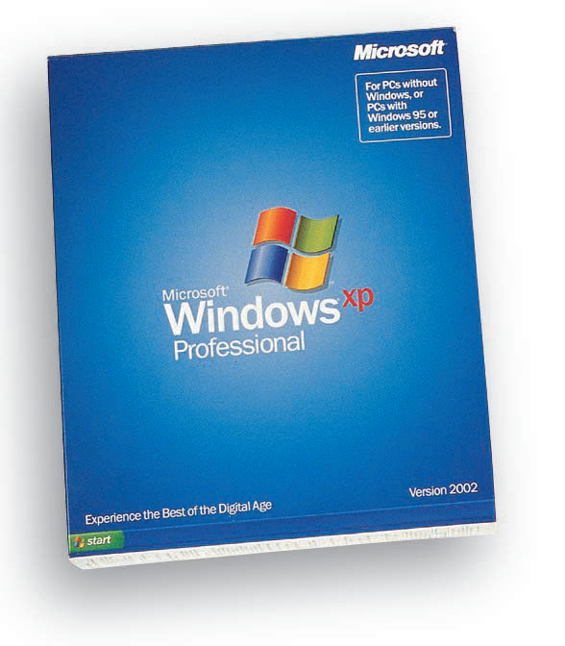
2001
Microsoft releases the Windows XP OS
XP version of Microsoft Office also is unveiled.
Several versions of recordable DVD discs and drives produced
DVD-R, DVD+R, DVD-RAM
18

Slide 19
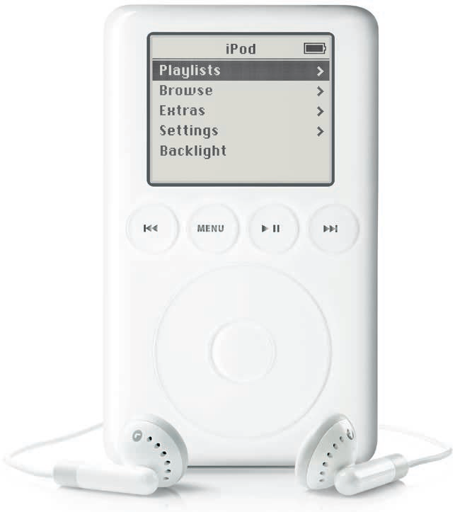
2001
Apple introduces OS X, a new OS for Macintosh computers
based on BSD (Berkley Software Distribution) Unix with a beautiful graphical interface
Apple introduces the iPod
premier music player with a 5 GB internal hard disk that will store 1,000 CD-quality songs
19

Slide 20
2002 Open Office
OpenOffice.org announces the release of OpenOffice.org 1.0,
A free, full-featured suite of productivity applications compatible with the file formats used by Microsoft Office and many other office suites.
An open-source alternative to expensive application suites
OpenOffice.org runs under Windows, Solaris, Linux, the Mac OS, and other operating systems.
20

Slide 21
2002
Microsoft launches its .NET strategy
New environment for development and running s/w applications featuring ease of use and web based services
DVD writers begins to replace CD writers
Digital Video cameras are introduced
Tablet PC is introduced as next generation mobile PC
Intel ships Pentium 4 chip with Hyper Threading (HT) technology, 3.06GHz
21

Slide 22
2003
Microsoft launches MS Office 2003
More than 400 million people in 175 nations and 70 languages are using a version Office
Latest OS include support for Wi-Fi (Wireless Fidelity) and Bluetooth standards
Use of wireless keyboards, mouse devices, home networks and wireless internet access points become common
Apple opens an online music store iTunes
Offering more than 200,000 titles at $0.99 each
22

Slide 23
2004
Apple iTunes sold nearly 20 million songs
USB Flash drives are produced
Flat Panel LCD monitors
Radio Frequency Identification(RFID) tags are introduced
Smart Phones overtakes the PDA as the personal mobile device of choice.
Apple Computer introduces iMac G5
Computer display device contains the system unit
23

Slide 24
2005
Apple releases the latest version of iPod Portable
Microsoft introduces Visual studio 2005
Microsoft releases the Xbox 360 game console
Blogging and podcasting become mainstream
24

Slide 25
2006
Sony launches its PlayStation 3
Google becomes the most used search engine capturing 54% of market share
Intel introduces Core 2 Duo processor family
Contains 291 million transistors
Apple begins selling Macintosh computers with Intel microprocessors
IBM produces the fastest supercomputer called Blue Gene/L
Perform 28 trillion calculations in a blink of an eye i.e. about 1/10th of a second
25

Slide 26
2007
Microsoft releases Office 2007 suite
Microsoft Windows Vista OS is introduced.
Blu-ray and HD DVD increase in popularity
Intel introduces Core 2 Quad
Four core processor made for dual processor servers and desktop computers
Larger number of cores allows for more energy-efficient performance
Apple introduced iPhone and sells 270,000 phones in first 2 days
26

Slide 27
2008
Microsoft introduces Windows server 2008
Successor to Windows server 2003
Online social networks continue to grow in popularity
MySpace, Facebook and Twitter are the most widely used
Combined social networking Websites total almost 1 billion users
YouTube continues to gain users
WiMAX goes live
Capability to access video, music, voice and video calls wherever and whenever desired
Average download speeds between 2-4 Mbps
27

Slide 28
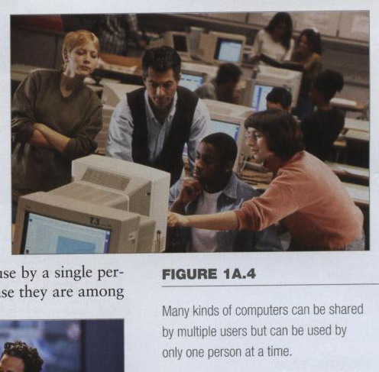
Computers for Individual Use
Computers can
be shared by
multiple users
but can be used
by only one
person at a time.

Slide 29
Computers for Individual Use
Six primary types of Personal Computers (PCs)
Desktop computers
Workstations
Notebook computers
Tablet Computers
Handheld computers
Smart Phones
Notes:
a term that refers to any computer system that is designed for use by a single person.
Personal computers arc also called microcomputers because they are among the smallest computers created for people to use.

Slide 30
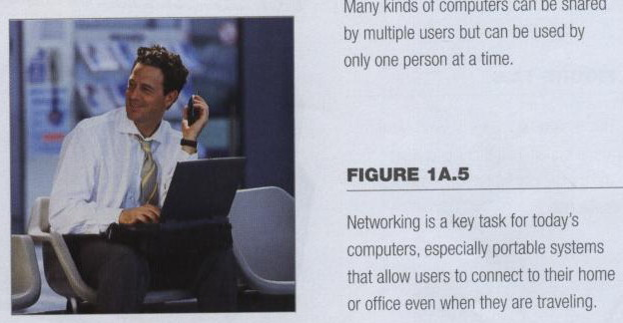
Computers for Individual Use
Although PCs are used by individuals,
they also can be connected together to create networks.
Notes:
Insider information
System units are commonly called cases. Many computer enthusiasts customize or ‘mod’ their cases with windows and lights. See www.casemodgod.com for examples of cases and products.
Sun Microsystems makes the most popular workstations on the planet. Sun’s systems are used in diverse applications such as medical imaging and CGI (computer generated image) animation.
Infact, networking has become one of the most important jobs of personal computers, and even tiny handheld computers can now be connected to networks.

Slide 31
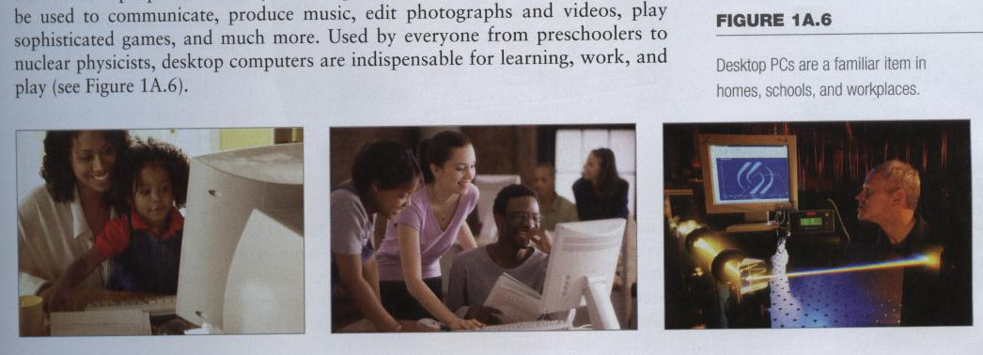
Desktop Computers
The most common type of computer
Sits on the desk or floor
Performs a variety of tasks
You see all around you in schools, home and offices
Notes:
Today's desktop computers are far more powerful than those of just a few years ago, and are used for an amazing array of tasks. Not only do these machines enable people to do their jobs with greater ease and efficiency, but they can be used to communicate, produce music, edit photographs and videos, play sophisticated games, and much more. Used by everyone from preschoolers to nuclear physicists, desktop computers arc indispensable for learning, work, and play (see Figure !A .6).

Slide 32
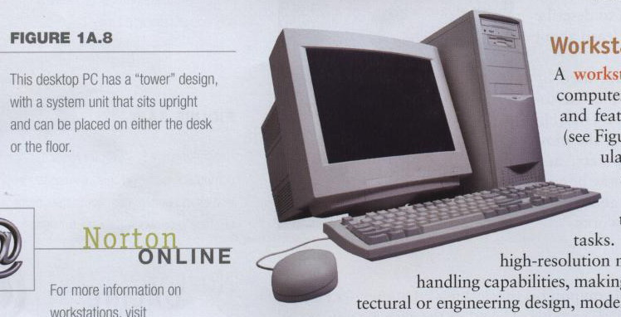
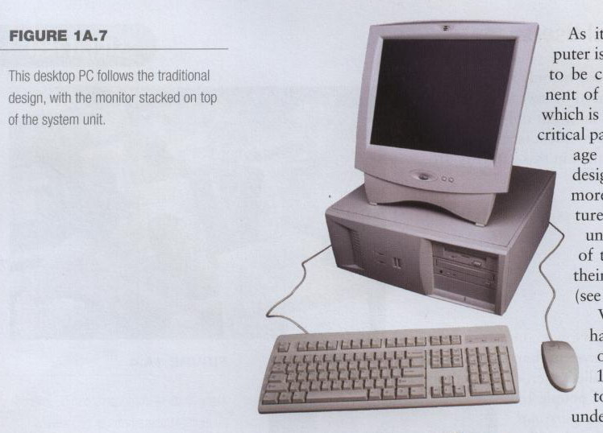
Desktop Computers
Different design types
Desktop Model
Tower model
Notes:
As its name implies, a desktop computer is a full-size computer that is too big to be carried around. The main component
of a desktop PC is the system unit, which is the case that houses the computer’s critical parts, such as its processing and storage
devices.
There are two common designs for desktop computers.
The more traditional desktop model features a horizontally oriented system unit, which usually lies flat on the top of the user’s desk. Many users place their monitor on top of the system unit (see Figure 1A.7).
Vertically oriented tower models have become the more popular style . of desktop system (see Figure V 1A.8). This design allows the user
to place the system unit next to or under the desk, if desired.

Slide 33
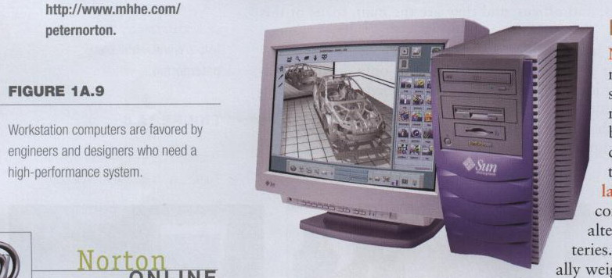
Workstations
Specialized single-user computers
Optimized for science or graphics
More powerful than a desktop
Notes:
A workstation is a specialized, single-user computer that typically has more power and features than a standard desktop PC (see Figure 1A.9).
These machines are popular among scientists, engineers, and animators who need a system with greater-than-average speed and the power to perform sophisticated tasks.
Workstations often have large, high-resolution monitors and accelerated graphics handling capabilities, making them suitable for advanced architectural or engineering design, modeling, animation, and video editing.

Slide 34
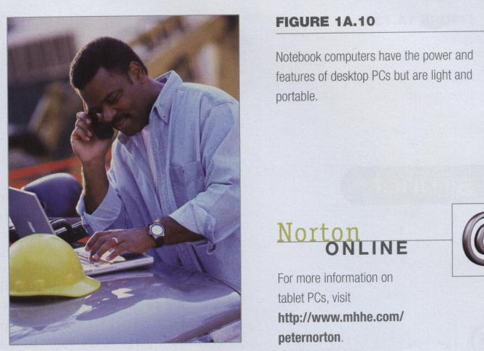
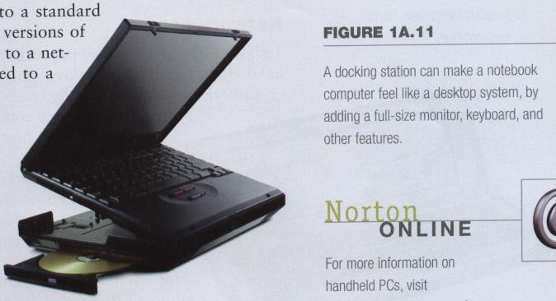
Notebook Computers
Small portable computers
Weighs between 3 and 8 pounds
About 8 ½ by 11 inches
Notes:
Discussion point
Have students contrast desktop and notebook computers. Focus on the pros and cons of each type of computer.
Notebook computers, as their name implies, approximate the shape of an 8.5-by-ll-inch notebook and easily fit inside a briefcase. Because people frequently set these devices on their lap, they are also called laptop computers.
Notebook computers can operate on alternating current or special batteries.
These amazing devices generally weigh less than 8 lbs, and some even weigh less than 3 lbs!
During use, the computer’s lid is raised to reveal a thin monitor and a keyboard.
When not in use, the device folds up for easy storage.
Notebooks arc fully functional microcomputers; the people who use them need the power of a full-size desktop computer wherever they go (see Figure I A.10). Because of their portability, notebook PCs fall into a category of devices called mobile computers—systems small
enough to be carried by their user.
Some notebook systems are designed to be plugged into a docking station, which may include a large monitor, a full-size keyboard and mouse, or other devices (see Figure 1A.11).
Docking stations also provide additional ports that enable the notebook computer to be connected to different devices or a network in the same manner as a desktop system.

Slide 35
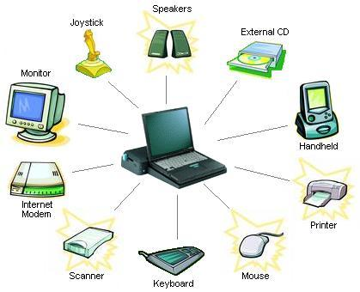
Notebook Computers
Docking station
provide additional ports that enable the notebook computer to be connected to different devices or a network in the same manner as a desktop system

Slide 36

Tablet Computers
Newest development in portable computers
Input is through a stylus or digital pen
Run specialized versions of office products
Some models have a fold-out keyboard
Some models can be connected to a keyboard and a full-size monitor
Notes:
Teaching tip
The tablet PC was designed to simulate a piece of paper. Users interact with the tablet as if it was an unlimited paper notebook.
For more information
See www.microsoft.com/windowsxp/tabletpc/evaluation/tours/default.mspx for an example of the Tablet PC in action.
Tablet PCs offer all the functionality of a notebook PC, but they are lighter and can accept input from a
special pen—called a stylus or a digital pen—that is used to tap or write directly on the screen.
Many tablet PCs also have a built-in microphone and special software that accepts input from the user's voice. A few models even have a fold-out keyboard, so they can be transformed into a standard notebook PC. Tablet PCs run specialized versions of standard programs and can be connected to a network.
Some models also can be connected to a keyboard and a full-size monitor.

Slide 37
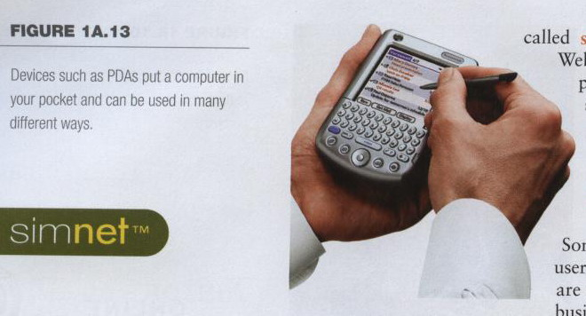
Handheld PCs
Palm computer
Very small computers
Personal Digital Assistants (PDA)
Note taking or contact management
Data can synchronize with a desktop
Notes:
Handheld personal computers are computing devices small enough to fit in your hand (see Figure 1 A. 13).
A popular type of handheld computer is the personal digital assistant (PDA). A PDA is no larger than a small appointment book and is normally used for special applications, such as taking notes, displaying telephone numbers and addresses, and keeping track of dates or agendas. Many PDAs can be connected to larger computers to exchange data.
Most PDAs come with a pen that lets the user write on the screen. Some handheld computers feature tiny built-in keyboards or microphones
that allow voice input.
Many PDAs let the user access the Internet through a wireless connection, and several models offer features such as cellular telephones,
cameras, music players, and global positioning systems.

Slide 38
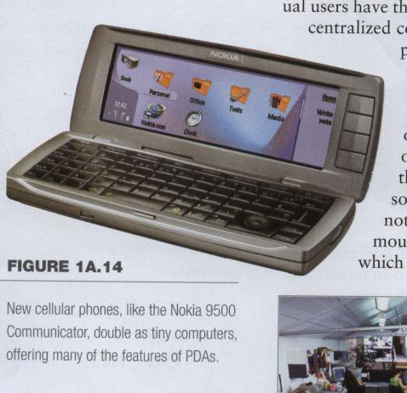
Smart Phones
Smart phones
Hybrid of
cell phone
and PDA
Web surfing,
e-mail access
Notes:
Some cellular phones double as miniature PCs (see Figure 1A.14). Because these phones offer advanced features not typically found in cellular phones, they are sometimes called smart phones.
These features can include Web and e-mail access, special software such as personal organizers, or special hardware such as digital cameras or music players. Some models even break in half to reveal a miniature keyboard.

Slide 39
Computers for Organizations
Some computers handle needs of many users at the same time.
These powerful systems are used by organizations such as businesses or schools
Commonly found at the heart of the organization network
Network servers
Mainframe computers
Minicomputers
Supercomputers

Slide 40
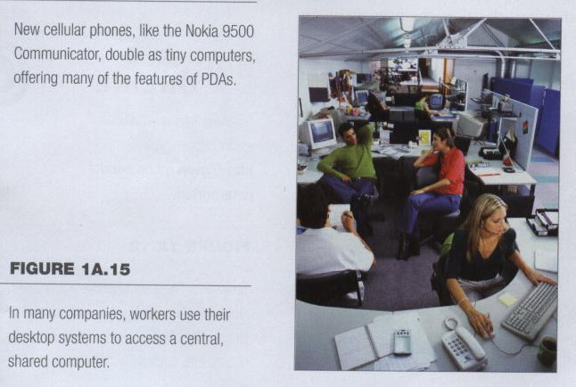
Network Servers
Network servers
Centralized computer
All other computers connect
Notes:
Today, most organizations’ networks are based on personal computers. Individual users have their own desktop computers, which are connected to one or more centralized computers, called network servers. A network server is usually a powerful personal computer with special software and equipment that enable it to function as the primary computer in the network.

Slide 41
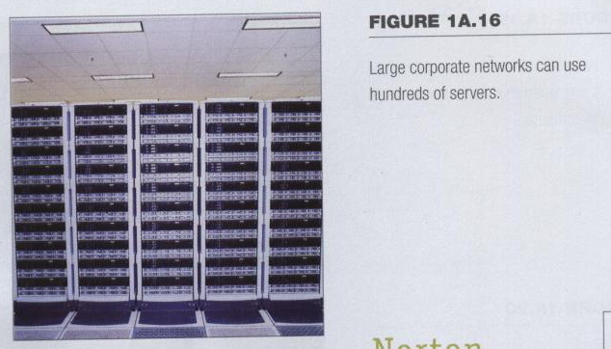
Network Servers
Provides access to network resources
Multiple servers are called server farms
Often simply a powerful desktop: Google
Notes:
PC-based networks and servers offer companies a great deal of flexibility. For example, large organizations may have dozens
or hundreds of individual servers working together at the heart of their network (see Figure 1A.16).
When set up in such groups—sometimes called clusters or server farms—network servers may not even resemble standard PCs. For example, they may be mounted in large racks or reduced to small units called “ blades,“ which can he slid in and out of a case. In these large networks, different groups of servers may have different purposes, such as supporting a certain set of users, handling printing tasks, enabling Internet communications, and so on

Slide 42
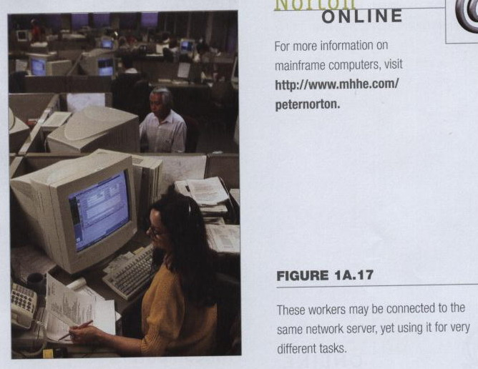
Network Servers
Flexibility to different kinds of tasks
Computers for Organizations
Computers for Organizations
Notes:
A PC-based server gives users flexibility to do different kinds of tasks (see Figure I A.17). This is because PCs are general-purpose
machines, designed to be used in many ways.
For example, some users may rely on the server for e-mail access, some may use it to perform accounting tasks, and others may use
it to perform word-processing or database management jobs.
The server can support these processes, and many others, while storing information and programs for many people to use.

Slide 43
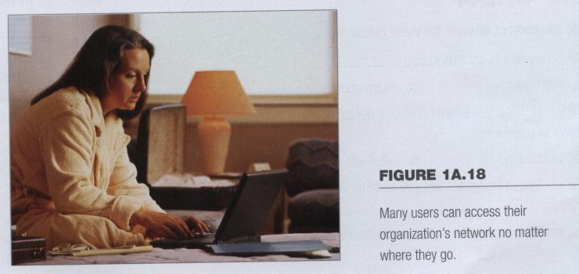
Network Servers
Users use the Internet as a means of connecting even if away from the offices.
Notes:
Depending on how the network is set up, users may be able to access the server in multiple ways. Of course, most users have a standard desktop PC on their desk that is permanently connected to the network.
Mobile users, however, may be able to connect a notebook PC or a handheld device to the network by wireless means. When they are away from the office, users may be able to use the Internet as a means of connecting to the company’s network servers (see Figure 1A.18)

Slide 44
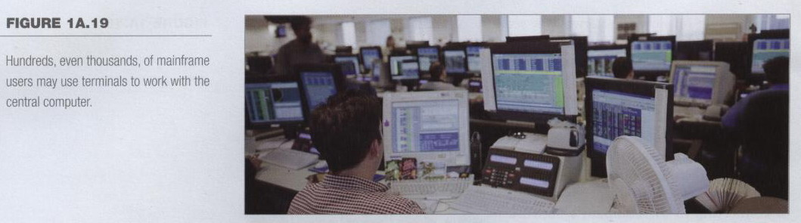
Mainframes
Used in large organizations
Handle thousands of users
Users access through a terminal
Notes:
Mainframe computers are used in large organizations such as insurance companies and banks, where many people frequently
need to use the same data. In a traditional mainframe environment, each user accesses the mainframe’s resources through a device called a terminal (see Figure 1A.19).
There are two kinds of terminals. A dumb terminal does not process or store data; it is simply an input/output (I/O ) device that functions as a window into a computer located somewhere else.
An intelligent terminal can perform some processing operations, but it usually does not have any storage. In some mainframe environments, however, workers can use a standard personal computer to access the mainframe

Slide 45
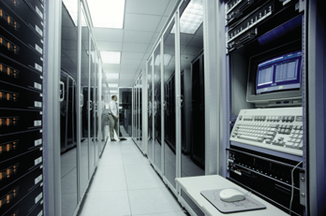
Mainframes
Large and powerful systems
Notes:
Mainframes are large, powerful systems (sec Figure 1 A.20). The largest mainframes can handle the processing needs of thousands of users at any given moment. But what these systems offer in power, they lack in flexibility. Most mainframe systems are designed to handle only a specific set of tasks. By limiting the number of tasks the system must perform, administrators preserve as much power as possible for
required operations.
You may have interacted with a mainframe system without even knowing it. For example, if you have ever visited an airline’s Web site to reserve a seat on a flight, you probably conducted a transaction with a mainframe computer.

Slide 46
Minicomputers
Called midrange computers
Power between mainframe and desktop
Handle hundreds of users
Used in smaller organizations
Users access through a terminal
Notes:
The capabilities of a minicomputer are somewhere between those of mainframes and personal computers. For this reason, minicomputers are often called midrange computers.
Like mainframes, minicomputers can handle much more input and output than personal computers can. Although some ‘‘minis’’ arc designed for a single user, the most powerful minicomputers can serve the input and output needs of hundreds of users at a time. Users can access a central minicomputer through a
terminal or a standard PC.

Slide 47
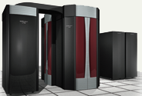
Supercomputers
The most powerful computers made
Handle large and complex calculations
Process trillions of operations per second
Found in research organizations
Notes:
Teaching tip
Students have a hard time understanding trillions of calculations. A simple explanation is to add 1 trillion random numbers together in a second. Contrast the speed of a super computer to the fastest desktop computer advertised during the week of class.
Supercomputers are the most powerful computers made, and physically they are some of the largest (see Figure I A.21). These systems can process huge amounts of data, and the fastest supercomputers can perform more than one trillion calculations per second.
Some supercomputers can house thousands of processors. Supercomputers are ideal for handling large and highly complex problems that require extreme calculating power. For example, supercomputers have long been used in the mapping of the human genome, forecasting weather, and modeling complex processes like nuclear fission.

Slide 48
Computers in Society
More impact than any other invention
“Computers have changed our world” or “Computers have changed the way we do”
Changed work and leisure activities
Used by all demographic groups
Computers are important because:
Provide information to users
Information is critical to our society
Managing information is difficult

Slide 49
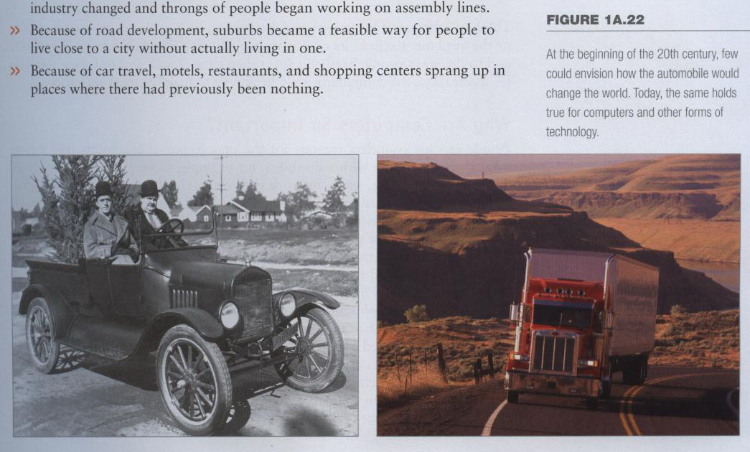
Impact of Computers
Like the Impact of automobile
Notes:
Life changed after the introduction of the automobile (see Figure 1A.22)? Consider a few examples:
» Because of the car; people were able to travel farther and cheaper than ever before, and this created huge opportunities for businesses to meet the needs of the traveling public.
» Because vehicles could be mass-produced, the nature of manufacturing and industry changed and throngs of people began working on assembly lines.
» Because of road development, suburbs became a feasible way for people to live close to a city without actually living in one.
» Because of car travel, motels, restaurants, and shopping centers sprang up in piaccs where there had previously been nothing-

Slide 50
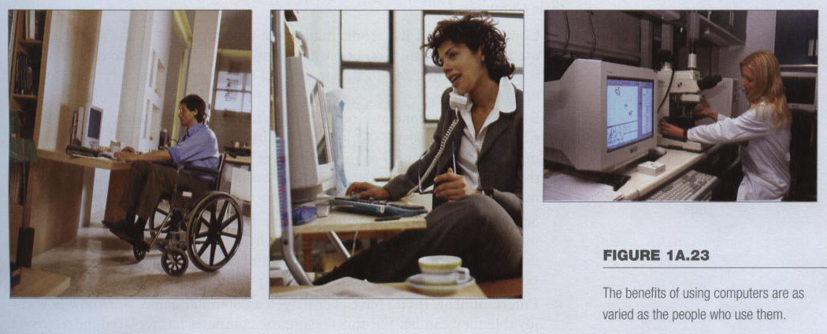
Benefits of Using Computers
As varied as users
For disabled person
For a sales professional
For a researcher
Notes:
People can list countless reasons for the importance of computers {see Figure 1A.23).
For someone with a disability, for example, a computer may offer freedom to communicate, learn, or work without leaving home.
For a sales professional, a PC may mean the ability to communicate whenever necessary, to track leads, and to manage an ever-changing schedule.
For a researcher, a computer may be the workhorse that docs painstaking and time-consuming calculations.
But if you took all the benefits that people derive from computers, mixed them together, and distilled them down into a single element, what would you have? The answer is simple: information.
Computers are important because information is so essential to our lives. And information is more than the stuff you see and hear on television. Facts in a textbook or an encyclopedia are information, bur only one kind.
Mathematical formulas and their results are information, too, as are the plans for a building or the recipe for a cake. Pictures, songs, addresses, games, menus, shopping lists, resumes— the list goes on and on. All these things and many others can be thought of as information, and they can all be stored and processed by computers. (Actually, If you work in one place and need to perform various tasks,
a desktop computer is the best choice.
Choose a desktop computer if you want to
» Work with Graphics-Intensive or Desktop Publishing Applications. Complex graphics and page-layout programs require a great deal of system resources, and a desktop system’s large monitor reduces eye fatigue.
» Design or Use Multimedia Products. Even though many portable computers have multimedia features, you can get the most for your money with a desktop system. Large screens make multimedia programs easier to see, and stereo-style speakers optimize sound quality.
» Set Up Complex Hardware Configurations. A desktop computer can support multiple peripherals—including printers, sound and video sources, and various external devices—at the same time. If you want to swap components, or perform other configuration tasks, a desktop
system will provide many options

Slide 51
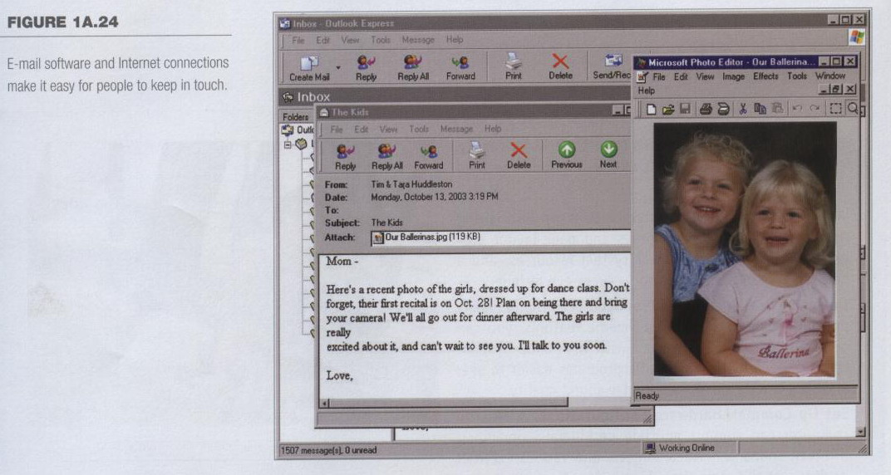
Computers at Home
Many homes have multiple computers
Most American homes have Internet
Computers are used for
Communication (e-mail)
Notes:
Insider information
The 2000 Census determined that 51% of American households had computers. Over 42% of these households also had Internet access. This can be contrasted to 36% and 18% in 1997. See www.census.gov/prod/2001pubs/p23-207.pdf for more information.
In many American homes, the family computer is nearly as important as the refrigerator or the washing machine. People cannot imagine living without it. In fact, a growing number of families have multiple PCs in their homes; in most cases, at least one of those computers has an Internet connection. Why do home users need their computers?
» Communications. Electronic mail (e-mail) continues to be the most popular use for home computers, because it allows family members to communicate with one another and to stay in contact with friends and coworkers (see Figure 1A.24).

Slide 52
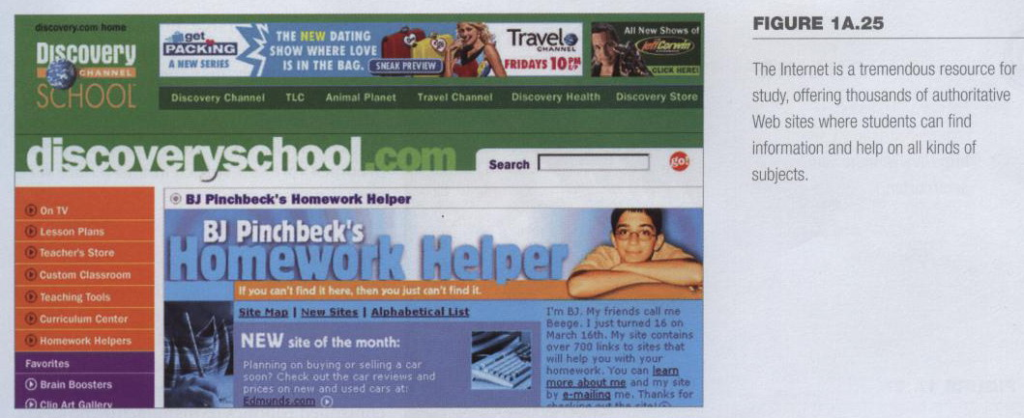
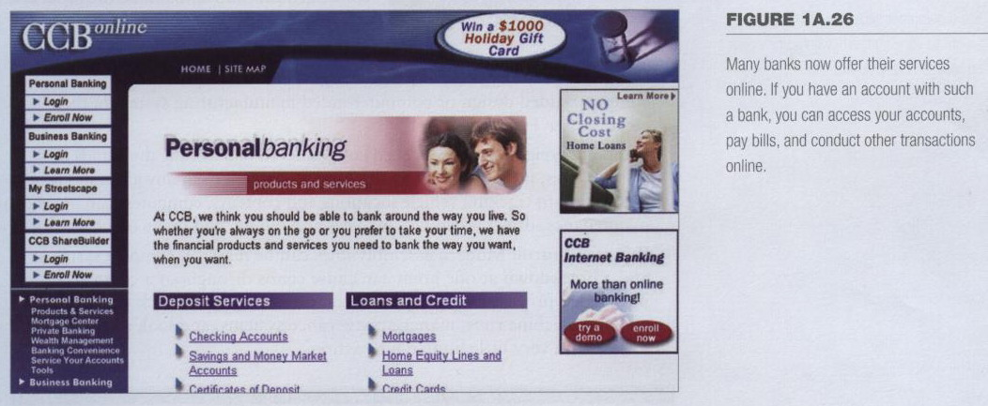
Computers in Society
Computers at home
Computers are used for
Business
Entertainment
Schoolwork
Finances
Notes:
» Business Work Done at Home. Thanks to computers and Internet connections, more people arc working from home than ever before. It is possible for many users to connect to their employer’s network from home and do work that could not be done during regular business hours. Computers also are making it easier for people to start their own home-based businesses.
» Schoolwork. Today’s students are increasingly reliant on computers, and not just as a replacement for typewriters. The Internet is replacing printed books as a reference tool (see Figure 1A.25), and easy-to-use software makes it possible for even young users to create polished documents.
» Entertainment. If you have ever played a computer game, you know how enjoyable they can be. For this reason, the computer has replaced the television as the entertainment medium of choice for many people. As computer; audio, video, and broadcast technologies converge, the computer w ill someday be an essential component of any home entertainment center.
» Finances.'Computers and personal finance software can make balancing your checkbook an enjoyable experience. Well, almost. At any rate, they certainly make it easier, and home users rely on their PCs for bill paying, shopping, investing, and other financial chores (see Figure 1A.26).

Slide 53
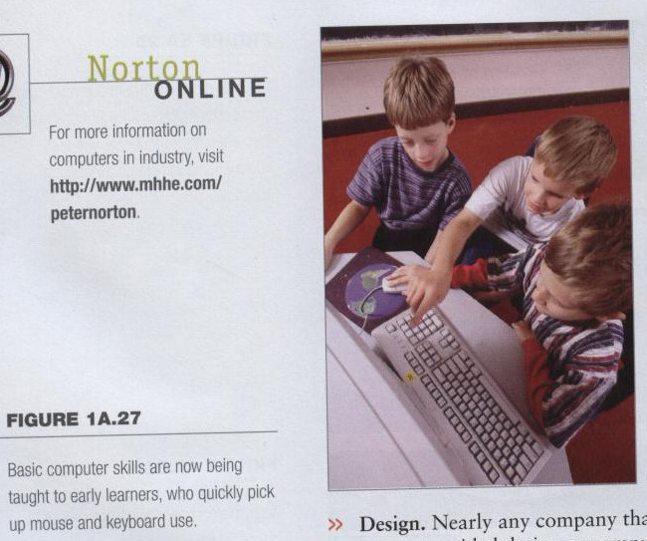
Computers in Education
Computer literacy required at all levels
More and more schools are adding computer technology to their curricula
Educators see computer technology as an essential learning requirement for all students, starting as early as preschool
Notes:
Insider information
Specialized mountain bikes are designed on Sun workstations.
More and more schools are adding computer technology to their curricula, not only teaching pure computer skills, but incorporating those skills into other classes. Students may be required to use a drawing program, for example, to draw a plan of the Alamo for a history class, or use spreadsheet software to analyze voter turnouts during the last century’s presidential elections.
Educators see computer technology as an essential learning requirement for all students, starting as early as preschool. Even now, basic computing skills such as keyboarding are being taught in elementary school classes (see Figure 1A.27).
In the near future, high school graduates w ill enter college not only with a general diploma, but with a certification that proves their skills in some area of computing, such as networking or programming.

Slide 54
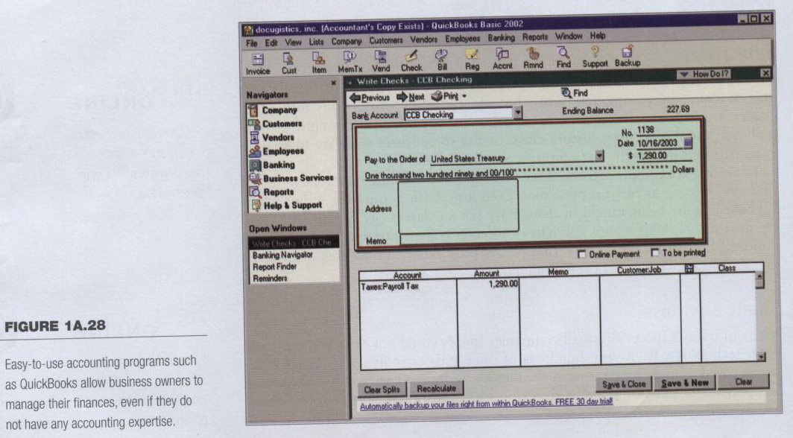
Computers in Small Business
Makes businesses more profitable
Allows owners to manage and grow their companies
Notes:
These tools enable business owners to handle tasks—such as daily accounting chores, inventory management, marketing, payroll, and many others—that once required the hiring of outside specialists (see Figure 1A.28). As a result, small businesses bccome more self-sufficient and reduce their operating expenses.

Slide 55
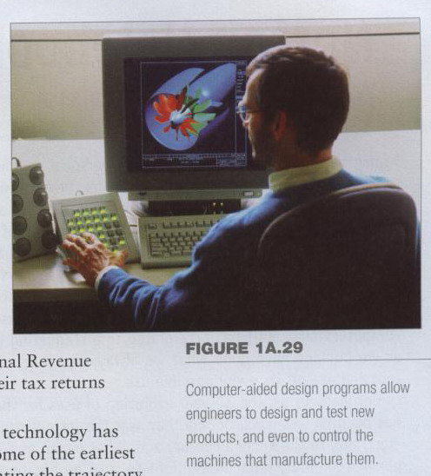
Computers in Industry
Computers in industry
Computers are
used to design
products
Assembly
lines are
automated
Notes:
A corporate headquarters may have a standard PC-based network, for example, but its production facilities may use computer controlled robotics to manufacture products. Here are just a few ways computers are applied to industry:
» Design. Nearly any company that designs and makes products can use a computer-aided design or computer-aided manufacturing system in their creation (sec Figure 1A.29).
» Shipping. Freight companies need computers to manage the thousands of ships, planes, trains, and trucks that are moving goods at any given moment. In addition to tracking vehicle locations and contents, computers can manage maintenance, driver schedules, invoices and billing, and many other activities.
» Process Control. Modem assembly lines can be massive, complex systems, and a breakdown at one point can cause chaos throughout a company. Sophisticated process-control systems can oversee output, check the speed at which a machine runs, manage conveyance systems, and look at parts inventories, with very little human interaction.

Slide 56
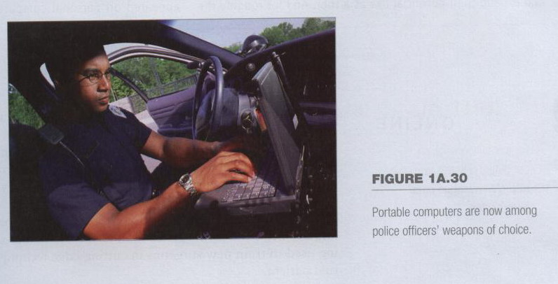
Computers in Government
Necessary to track data for population
Police officers
Tax calculation and collection
Governments were the first computer users
Notes:
Teaching tip
Most state departments of motor vehicles rely on a mainframe computer. Officers access the mainframe from a remote intelligent terminal.
Today, computers play a crucial part in nearly every government agency:
» Population. The U.S. Census Bureau was one of the first organizations to use computer technology, recruiting mechanical computers known as “difference engines" to assist in tallying the American population in the early 20th century.
»Taxes. Can you imagine trying to calculate Americans’ tax bills without the help of computers? Neither could the Internal Revenue
Service. In fact, the IR S now encourages taxpayers to file their tax returns online, via the Internet.
Military. Some of the world's most sophisticated computer technology has been developed primarily for use by the military. In fact, some of the earliest digital computers were created for such purposes as calculating the trajectory of missiles. Today, from payroll management to weapons control, the armed forces use the widest array of computer hardware and software imaginable.
Police. When it comes to stocking their crime-fighting arsenals, many police forces consider computers to be just as important as guns and ammunition (see Figure 1A.30). Today’s police cruisers are equipped with laptop computers and wireless Internet connections that enable officers to search for information on criminals, crime scenes, procedures, and other kinds of information.

Slide 57
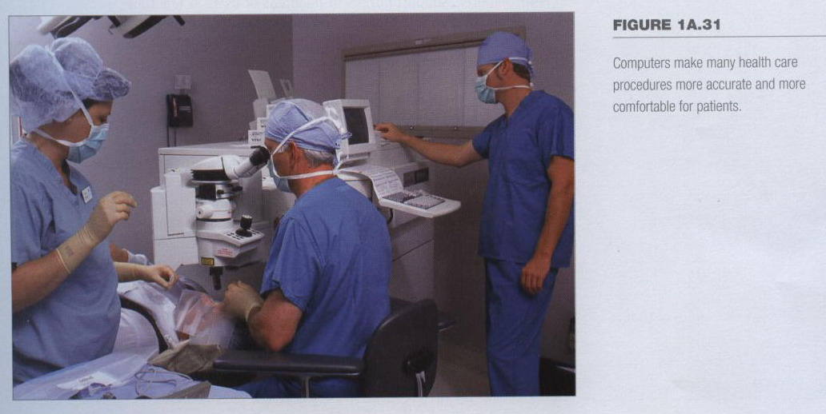
Computers in Health Care
Revolutionized health care
New treatments possible
Scheduling of patients has improved
Delivery of medicine is safer
Notes:
Discussion point
Page 19 of the text introduces the first Norton Notebook, the Merging of Media and Meaning. The author draws an analogy between electricity and computers in our lives. Discuss with your students how difficult live would be without either of these devices. Remember that computers exist in nearly all of our modern devices, including cars, phones, kitchen appliances and entertainment devices.
Computers, in fact, are making health care more efficient and accurate while helping providers bring down costs.
Many different health care procedures now involve computers, from ultrasound and magnetic resonance imaging, to laser eye surgery and fetal monitoring (seeFigure 1A.31).
Surgeons now can use robotic surgical devices to perform delicate operations, and even to conduct surgeries remotely. New virtual-reality technologies are being used to train new surgeons in cutting-edge techniques, without cutting an actual patient.
But not all medical computers arc so high-tech. Clinics and hospitals use standard computers to manage schedules, maintain patient records, and perform billings. Many transactions between physicians, insurance companies, and pharmacies are conducted by computers, saving health care workers time to devote to more important tasks.

Slide 58
Summary
Developments in Microcomputers
From 1984 to 2008
Computer for Individual Use
Computer for Organizations
Computers in Society

